Slide 1

Microsoft Teams meeting
Click here to join the meeting
Meeting ID: 362 846 369 233
Passcode: mwPUmq
Download Teams | Join on the web
Or call in (audio only)
+44 20 3855 5885,,53179477# United Kingdom, London
Phone Conference ID: 531 794 77#
DER Technical Forum
31 October 2023
10:00 – 12:00

Slide 2
Welcome, Housekeeping and Introductions

Slide 3
Agenda
10:00 | Welcome, Introductions and Acceptance of Agenda.
10:05 | Actions from previous meeting
10:10 | Redesign of DER TF Issues List
10:20 | Update on BESS issues
10:30 | New Issue – IONs for Type C?
10:50 | Customer Islanding
11:05 | Update on existing issues
11:15 | Other Updates GC0117 - extension of Grid Code to embedded generation EU developments
11:30 | AOB
 | Next Meeting Arrangements

Slide 4
Actions from previous meeting

Slide 5
Actions
Circulate NGESO guidance documents:
  all are here: https://www.nationalgrideso.com/industry-information/codes/grid-code-gc/grid-code-documents
NI G99 update schedule – anticipated early next year.

Slide 6
Updated DER TF Issues Summary

Slide 7
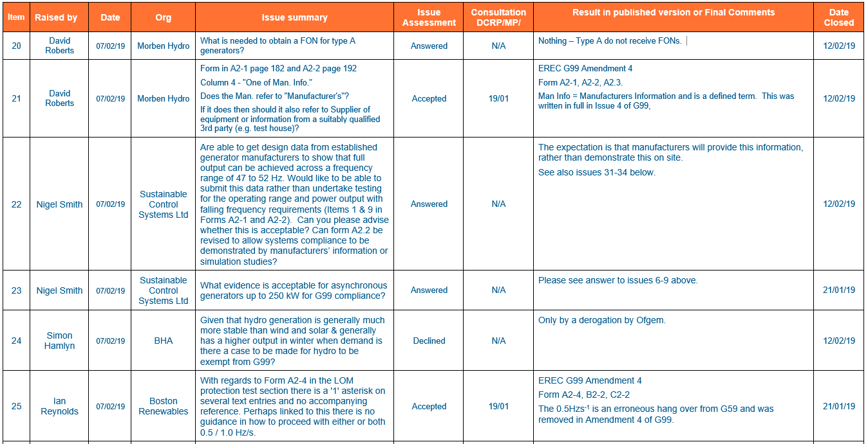
Proposed new summary of DER TF Issues.

Slide 8
Battery Energy Storage Systems

Slide 9
Progress since last meeting
Previously we committed that the ENA would work up with each DNO an appropriately detailed flow chart of each DNO’s approach which DNOs could then evaluate for consistency, and potentially publish on an individual basis.
Progress to date
  five of the six DNOs have agreed the representation at high level of the flow of BESS applications, particularly highlighting the voltage/P28 relevant stages – one is currently outstanding.
  Two lots of two DNOs appear to have the same process – but with minor differences between the two pairs.
  One DNO is currently different from the other four in that they do not accept that lack of frequency contract obviates the need for BESS interaction studies.
The intent is to share these at the next meeting with stakeholders (date to be arranged) with a view to prompting further discussion for further refinement, and making the processes transparent. DNOs need to be comfortable with this.

Slide 10
New Issues

Slide 11
New Issue
Our issue is specifically regarding Type C PPMs. We have a number of Type C (solar) sites across different DNOs. Looking at G99 section 18.2 there is no EON or ION in the connection process for Type C PPMs, and to achieve FON we need to complete tests that require at least 65% (full voltage control) or 85% (reactive power and frequency response tests) of the maximum export capacity to be generated. For solar sites that energise over the winter months, it is unlikely that they would have such irradiation needed to achieve the required export to complete those tests until spring/summer the following year. For Type D PPMs there is the ION to cover this type of situation and allow export during this period until testing can be completed and FON achieved.
Having discussed this with other developers there seems to be a consistent inconsistency. We have had varying processes for achieving FON from different DNOs as well as confusion and variance within the DNOs. I outline two examples:
DNO A issues a Nil Export Connection Agreement (export allowed for testing purposes only) and following all the tests that could be completed at the time, issued an ION and vary the Connection Agreement to allow full export. Following successful completion of the outstanding compliance tests the FON is then issued. This approach seems a pragmatic approach.
DNO B have stated that they require FON to be completed before they will counter sign the Connection Agreement and allow full export. This leads to a lot of confusion and questions over how we are going to be able to complete the testing which requires connection to the network and export without a Connection Agreement in place – they won’t offer a Nil Export initially but only the final Connection Agreement with the full requested Export Capacity. Further, this will result in our site that is due to energise in December, not being able to export until March/April when we have the required irradiation to complete the remaining testing and achieve FON.

Slide 12
New Issue – FONs and Connexion Agreements
Do we need a more standardized approach to establishing the connexion agreement, and its interaction with FONs?

Slide 13
Islanding of small generation

Slide 14
Definition of operating modes
The following diagram might better explain the modes of operation, and nomenclature, cf the existing drafting:
 |  | Parallel Operation
 |  | No | Yes
Customer Island Operation | Yes | Switched alternative | Long Term Parallel Operating with Islanding
 |  |  | Infrequent Short Term Parallel Operation
 | No | Not applicable | Long Term Parallel Operation

Slide 15
Proposed change to G99 structure:
Existing structure:
Section 7
    7.1 Operating Modes
      Summary
    7.2 Long Term Parallel
      Summary
    7.3 Infrequent Short Term Parallel
      Detail
    7.4 Switched Alternative
      Detail
Section 9.6
    9.6.1 Two Island Modes
      Summary
    9.6.2 Customer Island
      Detail (sparse!)
    9.6.3 DNO’s Island
      Detail
Proposed structure:
Section 7
    7.1 Operating Modes
      Summary
    7.2 Long Term Parallel
      Summary
    7.3 Infrequent Short Term Parallel
      Summary
    7.4 Switched Alternative
      Detail
Section 9.6
    9.6.1 Three Island Modes
      Summary
    9.6.2 Long Term Parallel with islanding
      Detail
    9.6.3 Infrequent short term parallel operation
      Detail
    9.6.4 – DNO’s Island
      Detail
Rationale:
Section 7 details with connexion requirements.
Section 9 provides the detail for specific issues, in this case island operation
Short Term Parallel is essentially island operation – so can be accommodated with other islanding details.
All the detail for customer islanding, including short term parallel is in 9.6.

Slide 16
Revised earthing diagrams - 1
Figure 8.7 - Typical Earthing Arrangement for an LV Power Generating Module Embedded within a Generator LV System and Designed for Independent (ie Standby) Operation Only Switched Alternative Operation Only

Slide 17
Revised earthing diagrams - 2
Figure 8.8 - Typical Earthing Arrangement for an LV Power Generating Module Embedded within a Generator LV System and Designed for Long Term Parallel Operation Only
It is proposed to supplement this diagram with one specifically based on inverters.

Slide 18
Revised earthing diagrams – 3
Figure 8.9 - Typical Earthing Arrangement for an LV Power Generating Module Embedded within a Generator LV System and Designed for both Independent Operation (ie Standby Operation) and Long Term Parallel Operation with Islanding.
To be supplemented by a single phase representation.

Slide 19
Revised earthing diagrams – 4
Rename diagrams 8.1 through to 8.6 as follows:
  Figure 8.1 - Typical Earthing Arrangement for an HV Power Generating Module Designed for Independent Operation Switched Alternative (ie Standby Operation) Only
  Figure 8.2 - Typical Earthing Arrangement for a HV Power Generating Module Designed for Long Term Parallel Operation Only
  Figure 8.3 - Typical Earthing Arrangement for an HV Power Generating Module Designed for both Independent Operation (ie Standby Operation) and Long Term Parallel Operation with Islanding
  Figure 8.4 - Typical Earthing Arrangement for two HV Power Generating Modules Designed for both Independent Operation (ie Standby Operation) and Long Term Parallel Operation with Islanding
  Figure 8.5 - Typical Earthing Arrangement for an LV Power Generating Module Connected to the DNO’s Distribution Network at HV and Designed for both Independent Operation (ie Standby Operation) and Long Term Parallel Operation with Islanding
  Figure 8.6 - Typical Earthing Arrangement for an LV Power Generating Module Embedded within a Generator HV System and Designed for both Independent Operation (ie Standby Operation) andLong Term Parallel Operation with Islanding

Slide 20
Islanding – additional diagrams
To show short term parallel arrangements as the earthing and neutral switching are different.
To show typical domestic full and partial back up arrangements – see next slides.
Also – do we want to standardize on the monochrome (existing version) or use colour as per the next examples, where appropriate?

Slide 21
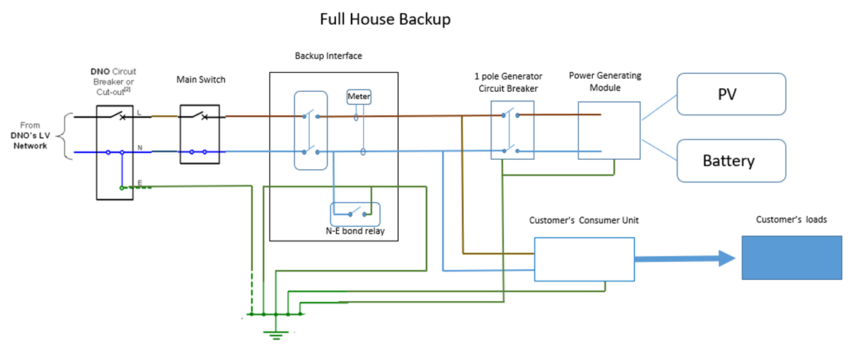
Full and partial back up of an installation by batteries - 1
Full backup

Slide 22
Full and partial back up of an installation by batteries - 2
Partial backup:

Slide 23
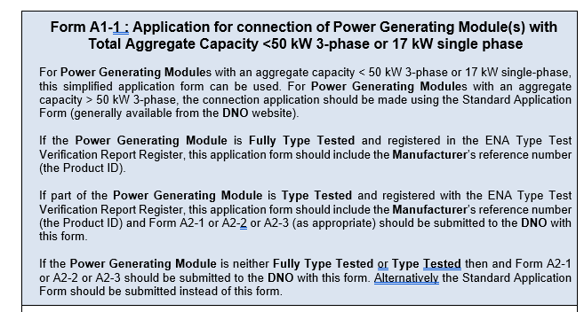
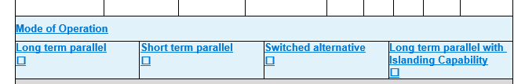
Annex – Application Forms
Indication of mode of operation on A1-1 & A1-2 (application forms)

Slide 24
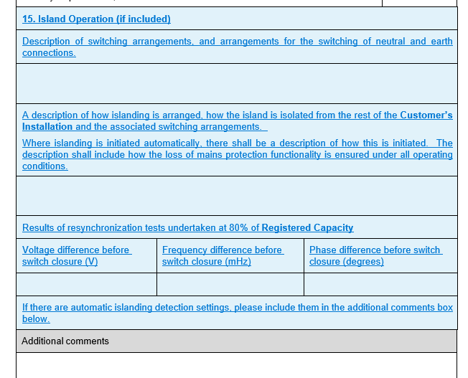
Annex – Compliance forms
Compliance confirmation in compliance verification forms (A2-1, A2-2, A2-3)
Also for the site commissioning forms A2-4, B2-2 and C2-2.

Slide 25
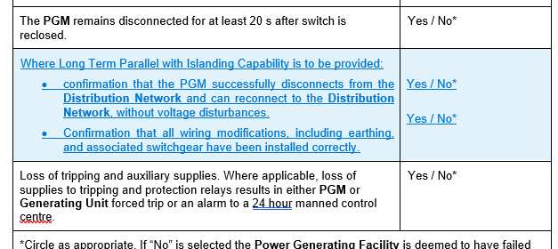
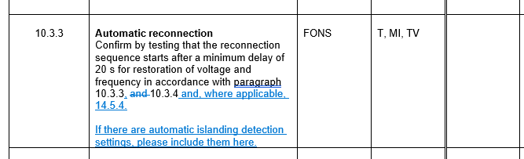
Installation Document and PGMD
Forms A3-1 and A3-2
Forms B2-2 and C2-2

Slide 26
Implications of fault ride through requirements
There could be an increasing wish by owners of sensitive plant to disconnect from the network and use self-supply to protect themselves from disturbances on the system.
This is a growing, albeit still theoretical, problem in Europe where very large data centres (hundreds of MW) are arranging to suddenly drop their load from the grid and pick it up on their similarly sized UPS capabilities. The EU TSOs are quite worried about this.
The law requires all customers with generation to remain connected through a voltage excursion at their connexion points as defined by the FRT requirements. But says nothing about other voltage disturbances.
There is also an issue that some UPS run in parallel for less than 5 minutes per month, so are exempt from the RfG – and therefore treated as demand.
In this case, the EU TSOs are thinking about how to apply FRT requirements to demand.
This is also a GB DNO concern.
DNOs are considering if there is a case for us trying to future-proof G99 islanding requirements along these lines. See possible new clause 9.6.2.8 on next slide

Slide 27
New clause 9.6.2.8 for FRT
9.6.2.6. The earthing and changeover arrangements shall be designed in accordance with the requirements of Section 8 of this EREC G99 which are appropriate for both independent and parallel operation (eg figures 8.3, 8.4, 8.5, 8.6 for HV or 8.9 for LV, 8.10 for full backup operation). The exact designs of Customer’s Installations will vary, but the functional requirements of these figures shall be implemented. Power Generating Modules Manufacturers may choose to include the necessary switchgear integrated into the Power Generating Module, or provide the necessary control functions to switch external contactors.
9.6.2.7. It is the Generator’s responsibility to ensure appropriate and safe synchronisation to, and disconnection from, the DNO’s Distribution Network, respecting the requirements of EREC P28 on voltage disturbances on the DNO’s Distribution Network. .
9.6.2.8. Where generation, particularly where consisting of, or incorporating Electricity Storage, shall observe the Fault Ride Through requirements required in sections 11, 12 or 13 as appropriate. In other words, Customers’ Installations where large demands are supplied from the network, but are backed up by generation or Electricity Storage running in long term parallel mode, shall not trip from the network to run in island mode for voltage disturbances which require the connected generation to ride through and remain operating in parallel with the DNO’s Distribution Network.
9.6.2.9. Reconnection of the generation shall be in accordance with section 14.5 of this EREC G99.

Slide 28
Previous Issues

Slide 29
Outstanding Issues:
Delays associated with DNOs being able to submit Mod Apps to NGESO because of inadequate SAF data – 126 – The DNOs are still reviewing the SAF.
Initial P28 assessments for generation tripping and/or load rejection etc. – 127 – should be picked up in the guidance on P28 being developed by the ENA.
Meaning of “transient rating” wrt PPMs for fast fault current injection – 128 – awaiting feedback from the originator.
Older issues – included in the annex.
  Registered Capacity – 112
  BESS connexions – issues 113, 114
  Cybersecurity – 117 & 121 – to follow up with AMPS
  5 minutes per month for Short Term Paralleling – 122

Slide 30
GC0117

Slide 31
GC0117 – alignment of Large, Medium and Small across GB
NGESO are pushing for this to be concluded.
There seem to be a number of significant loose ends:
  Interaction of Large Power Stations active in the BM with conflicting ANM signals;
  Commercial/legal implications of the above;
  Robustness of NGESO’s financial modelling;
  Implications for week 24 data (ie resolution of imprecise legal text drafting);
  Other legal text issues remaining to be resolved;
  DNO visibility of ESO actions affecting DNOs’ flows;
  The effect on the connexions queue;
  Clarification of export limitation on registered capacity (although could be solved by another mod).
The WG will have to vote on the three main options before the Code Admin consultation – which is now due in December.
The three main options are:
  The baseline (ie existing arrangements unchanged)
  The original proposal (ie Large starts at 10MW in all of GB)
  WAGCM1 – extending the E&W arrangements (including Medium PSs) to GB

Slide 32
EU Developments

Slide 33
EU Network Codes – Summer 2023 Consultation
The key issues (at least for DNOs) are:
  Electromobility
  Certification
  Aggregation of generating units
  Storage
  Grid Forming
  Simulations and Models
The following slides give a little detail on the issues above – but only from a DNO perspective.

Slide 34
Electromobility
ACER is proposing three classes of V2G:
  <2.4kW – probably connected via a domestic plug/socket.
  2.4kW – 42kW – probably the bulk of EVs, and many will be DC connected. Requirements similar to Type A
  42kW – 1MW - requirements similar to Type B
The EU DSO Entity and ENTSO-e made a joint proposal to the June Grid Connexion European Stakeholder Committee that only two classes are required, split by connexion, ie AC or DC.
The DC requirements would NOT be treated separately from electricity storage modules – so not even really a class.
It is not currently clear which approach the final legal text will take.
All EVs to be certified – minimizing admin etc for both owners and DNOs

Slide 35
Certification – probably mandatory for EVs and heat pumps
Background (as MK understands it!)
  The concept was introduced in the NC RfG, DC etc in 2016
  The RfG drafting seems to be an EU description of the existing situation in Germany, Spain and possibly some other countries (although without the mandatory site certification that Germany requires)
  An equipment certificate must be awarded by an authorised certifier.
  The authorised certifier in turn must be accredited by a national authority in accordance with Regulation (EC) No 765/2008.
  (requirements for accreditation and market surveillance relating to the marketing of products and repealing Regulation (EEC) No 339/93)
Opportunities
  A (complete) certificate for a PGM (or heat pump) would mean that there is no RfG compliance assessment needed on site.
  This would allow the connexion of small scale generation to DSOs’ networks with minimum DSO interaction.
  This is particularly valuable for mass market developments such as domestic PV, and increasingly electric vehicles, domestic storage and heat pumps
Draft legal text for RfG 2.0 has now been developed and might appear in the version for EC approval.

Slide 36
Aggregation of generating units
It has always been the case that non-synchronous generating units on a site should be aggregated into a single power generating module.
ACER is proposing that this arrangement be stopped, and that aggregation would only be of like technologies – ie so this would stop the aggregation of, for example, PV and storage into a single PPM.
ENTSO-e is very against this, and the DNOs are supportive of ENTSO-e’s position because of:
  The risk of owners gaming the technology boundaries to avoid being a higher Type (eg two Type B PPMs rather than a single Type C PPM)
  Perceived unfairness of existing post-RfG customers.
Currently this remains unresolved and is likely to remain so until ACER and the Commission decide.

Slide 37
Grid Forming
Imposition of grid forming likely to lead to unintended islands.
The risk is accepted by ENTSO-e & ACER.
The current solution under discussion with ENTSO-e is to allow mandatory GF capability for larger PGMs which are connected to a substation (or on a dedicated feeder) where there is sufficient instrumentation and control to manage any unintended island (and shut it down or resynchronise).
Larger Type B PGMs would be caught by the above, but smaller Type Bs and Type As would have to have GF capability starting from when a nationally agreed road map has allowed time etc for DNOs to have adapted their systems.
RoCoF as anti-islanding protection is excluded from the new 4Hzs⁻¹ ride through requirements – although other frequency protection used for anti-islanding might need to be reviewed.

Slide 38
Simulations and models
To the extent that ACER’s draft legal text follows the text in the ISSM EG report, there is probably little to comment on as part of the current consultation.
The RfG does not appear to specify how the TSO will receive models from DNO connected generation, if the TSO requests it – maybe this is something for local TSO/DSO agreement?
In the longer term it might be that DNOs either individually or collectively will need to develop expertise in EMT modelling.

Slide 39
Storage
The ACER text fully implements the Expert Group on Storage’s recommendations.
Storage is just treated as part of the PGM, but with additional requirements for responding to emergency underfrequency conditions.
The proposed LFSM-U response is subtly different from that in the GB Grid Code – so may be a dilemma for G99 to chose which to follow. Probably the GB Grid Code as the characteristic is probably just another software selection for the GB market.

Slide 40
AOB and next meeting

Slide 41
Appendix – historic Forum issues

Slide 42
Outstanding Issues – 1
No | Issue | Assumed Status
112 | A common issue that keeps coming up is Registered Capacity vs design install and grid agreements. I have a specific case where the G99 and connection agreement is for 9MW, the developer undersized the inverters slightly. So it can only produce 8.5MW ( in round numbers) whilst operating in the 0.95 lag/lead range. This is what is shown when we do the G99 study, and we noted this shortfall. So the question arises, of what happens to the site now and what can it do. Specifically, 1) Is it’s new official RC 9MW or 8.5MW ie do they retain their original agreed capacity, or is this list back to the DNO? This is a common sticking point, taking the above example it cannot meet the 9MW required, but they may upgrade an inverter later to give them more MVAr headroom and it could then operate at 9MW. 2) If the DNO doesn’t want/need them to operate across the 0.95 lag/lead range can they then operate at 9MW active power and say unity or 0.98pf. In this case they are producing their official R, but their system design does not meet the required G99 standard for a 9MW site. | This is an issue that does re-appear from time to time. We have attempted to deal with it in the past in issues 40, 80 and 83. We went through it with slides at the 7 June 2022 DER TF. DNOs have summarized how they specify maximum capacities and power factors in their connexion agreements. We propose that we incorporate the material from the 7 June 2022 meeting into the next version of the DG guides

Slide 43
Outstanding Issues – 2 – in progress
No | Issue | Assumed Status
113 | P28 has the usual classifications of frequent events, infrequent events (4 per month) and very infrequent events (1 per 3 month)…. what should we be assessing a storage system performing a dynamic containment service as? The UK grid is reasonably stable, at the moment, but with more conventional plant dropping out, the power swings are going to get a bit more sever, and the DC type services will be getting worked more often. Classing it as a very infrequent event probably isn’t realistic, but what about infrequent events? I could see that it is possible that you could get to around the 4 events per month, although probably not at the full power swing. | This is a good point, and one that probably would benefit from a consistent consideration by DNOs. It might be sensible to base the frequency on the observed incidence of frequency excursions, over the last 18 months say, that trigger a specific level of response from such services. The response level might be set locally, and the P28 “frequency of event” set by the historic track of frequency excursions triggering that level of response. This can be calculated from the information NGESO publish monthly. This should be picked up as part of ongoing work to develop a common approach to BESSs between the DNOs. However, note that in the BESS discussions on 18/11 it was pointed out that the 3% limit essentially applies at any time once the transients have died away, so for BESS power swings the 3% probably applies in all cases, irrespective of frequency of event.

Slide 44
Outstanding Issues – 3 – in progress
No | Issue | Assumed Status
114 | We have concerns relating the voltage step change for Battery Energy Storage Systems (BESS) when the systems are designated for fast frequency response. A number of network operators define step change to be full declared export to full declared import for real power P and for reactive power Q. The FFR contracts do not have a contracted obligation to reverse the direction of reactive power flow and no obligation to match the fast MW response with a MVAr response. When importing, there is no obligation to operate at a particular power factor only to operate within a +/-0.95 range. If a full MW ramp has occurred, it is reasonable to assume the system is under stress. To reverse Q at this point would be the worst of all strategies at it would exacerbate the stress of the system by introducing an unnecessary voltage step. It is likely that EFR or FFR BESS is located at a point with a high X/R ratio (close to a BSP or GSP). Therefore a unit change in Q would have at least 10x the impact on at the voltage step that of a unit change in P. This Q reversal condition appears to be based on a false assumption about the default behaviour of inverters under FFR. We believe it is a matter for the customer to demonstrate through simulation the voltage step change under power reversal. It is a matter for the customer to produce a reactive power strategy that meets the constraints of the D Code and the connection offer. Confirmation of the simulation can be done via commissioning tests with frequency injection for smaller steps. The imposition of this requirement distorts the market by essentially limiting the capacity of a BESS scheme to around half the capacity of other technologies thus creating hidden barrier to the penetration of the technology. The customer should demonstrate how they meet the voltage step change challenge through modelling and if necessary to verify through commissioning demonstration, not for the network operator to impose a control philosophy. | To be picked up in the BESS sessions

Slide 45
Outstanding Issues – 4 – in progress
No | Issue | Draft response
117 | Need of Effective date: Even though the current amendment is classified as minor changes there are significant changes that would require time for manufacturers to update their PGMs to comply with recent requirements. Ex one of those is the Cyber security requirement. For changes like these that would require identifying and implement a solution to an already compliant machine would take significant time/cost. Hence any requirements that would require modification of existing hardware/software design would require an effective date from the current release (a minimum of 6 months is recommended) to enable the manufacturer to be compliant with up-to-date requirements. Currently, the exception is applicable only for certain technologies but is required to be made for all technologies. Please be mindful that it would take manufacturers some time to find an effective solution and to prove compliance. | We agree that any change of requirements will generally need a period before compliance is required to allow manufacturers and others to accommodate the new requirements. As you are probably aware the recent modification to introduce new requirements for storage built in a 12 month period for manufactures and developers to implement any required changes before compliance is required. It might be that this is what you have in mind when you refer to the exception in your last sentence? We do not believe that there are any changes that we have classified as minor in the most recent amendment that impose any new compliance requirements on manufacturers or developers. Even without a specific formal implementation period, manufacturers do have significant warning of even the minor changes. They are all discussed at the DER Technical Forum, often over more than one meeting, and are summarised in the slides for the Forum which are published. The changes are formally consulted on, providing both an opportunity to absorb the proposed changes, to assimilate the implications, and provide a response or challenge to the proposals. There is then a further period, usually a couple of months, before the modification is approved by the regulator and published. In regard of the new references for cybersecurity, there is no new specific performance or compliance requirements added at this time, simply an expectation that manufacturers will be applying industry good practices, as well as standards that manufacturers should already be working to, or adapting to. It might be that the requirements of the network licensees, as provider of critical national infrastructure, do become more specific in the future, but we recognize this is a developing area and we are initially seeking to apply guidance and a light touch. In conjunction with BEIS ENA has produced guidance for Distributed energy resources (DER) cyber security connection at https://www.energynetworks.org/operating-the-networks/managing-cyber-security. However we do note your concern over the most recent change and we will be happy to discuss any points relating to them, or modifications to ENA documents more generally.

Slide 46
Outstanding Issues – 5 – in progress
No | Issue | Draft response
121 | Minor corrections in G99 It is proposed to replace all "electricity storage devices" with "Energy storage devices". Currently, all the devices store the electricity in alternative energy form not as electric/charge form directly. Clarification on which requirements apply for Energy storage devices. As the word is included in synchronous machine and power pack modules. Synchronous machine working is limited by the machine's ability to fulfill grid codes, but convertor-based devices can be altered to fulfill stringent requirements due to electronic capability. Hence for devices that employing different technologies, it is recommended to keep the requirements separately and not to mix them. Clarity on what is the acceptable minimum level of cyber security required at the power generating module. Is it required for the power gen and the power generating control system components to be at the same security level as the facility and the ENA network? | G99 is a network oriented documented and as such it is blind to the storage medium. From the network perspective storage consumes electricity when charging, and produces electricity when discharging – ie a flow of electricity in and out. Energy storage includes heat storage, and electric vehicles, where the final output is heat and mechanical energy respectively, not electricity. The wording of the synchronous power generating module has been chosen deliberately to cater for technologies such as compressed air storage where the same synchronous machine is used for compression and expansion. In all cases the power generating module has to meet all the requirements for that technology, irrespective of how it is constituted. There are no specific requirements in G99 or G98 in relation to cybersecurity; only a general obligation to manage cyber risks appropriately.

Slide 47
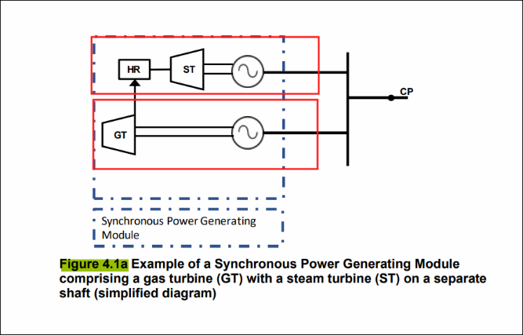
Outstanding Issues – 5 continued.
No | Issue | Draft response
121 | Gas turbine can work independent of Heat recovery system and might start working before HR blocks starts. Hence recommended to show as two different modules instead of one. As once synchronized, it is possible for GT to run independently from the HR block. Modification of synchronous power generating module definition: recommend to remove energy storage device unless it is a flywheel like device that would be used as power generating device (ex. Mechanical UPS system - rotary UPS) but these devices are least used against grid as it supports power backup for short duration and just a load on grid until the grid fails. | Figure 4.1a shows a single power generating module comprising two separate power generating units. Whilst it is true that the gas turbine unit can be run independently, it is assumed that the steam turbine cannot. If the steam turbine were capable of independent operation then there would indeed be two separate synchronous PGMs. However as the steam turbine (a) cannot run independently and (b) normally runs in tandem with the gas turbine, the two units comprise a single SPGM. As per (a) above the definition caters for technologies such as hydro pumped storage and compressed air storage. Short term energy storage devices such as flywheels, DRUPs etc are specifically excluded from G99 – see section 7.1.2: “Equipment other than Generating Units (eg traction loads, lift motors etc) may act as a short term source of energy, and inject electrical energy into the Customer’s Installation when they operate in a regenerative mode. In general EREC G99 will not apply as there will be no need to make any specific design accommodation for such equipment as it is unlikely that they will support any possible power island for a significant length of time. Where such equipment can act as a source of electrical energy for more than a few seconds (say typically 20 s), the DNO will advise the Customer if the Customer’s Installation requires any special consideration such as reverse power protection on a case by case basis.”

Slide 48
Outstanding Issues – 7
No | Issue | Assumed Status
122 | I represent a UK water industry working group responsible for the development and maintenance of electrical specifications. During recent work to update a specification for low voltage diesel generator sets, I was asked by the group to lobby the ENA technical committee responsible for G99 to consider relaxing the following clause in EREC G99: 7.3.3.1 parallel operation | 7.3.3.1 The Power Generating Module may be permitted to operate in parallel with the Distribution Network for no more than 5 minutes in any month, and no more frequently than once per week. If the duration of parallel connection exceeds this period, or this frequency, then the Power Generating Module shall be considered as if it is, or can be, operated in long-term parallel operation mode. An alternative frequency and duration may be agreed between the DNO and the Generator taking account of particular site circumstances and Power Generating Module design. An electrical time interlock should be installed to ensure that the period of parallel operation does not exceed the agreed period. The timer should be a separate device from the changeover control system such that failure of the auto changeover system will not prevent the parallel being broken. Notice that the highlighted text already allows for an agreement between the DNO and Generator to agree an appropriate testing regime, subject to there being a valid reason to do so. An alternative would be to fit full LoM protection and address any relevant points from 7.3.3.4, in which case the PGM would be treated as LTP. To be reviewed as part of the next update to G99.

Slide 49
Outstanding Issues – 8
No | Issue | Current Status
126 | Customers are still seeing very long delays for DNOs to submit a Modification Application to National Grid for the appropriate GSP. A developer accepted a scheme Sept 2020 and only had the Mod App response back August 2022 (even with pushing for a Mod App to be done with escalation). This is not an isolated experience. One part of the delay occurred as the DNO informed us they are allowing customers to only fill in sections 1 -3 before receiving a distribution offer, but required customers to fill in section 4 before they were able to submit the Mod App. Whilst the customer UBGC represented had filled in Part 4 when the scheme was applied for, others which accepted before had not and a Mod App was further delayed, to allow customers who accepted ahead to fill in the form. This would have been 14+ months after they had initially accepted their offers. If Part 4 is a requirement for a Mod App but the DNO feels comfortable making a distribution offer without part 4, can it be agreed that part 4 it is filled in within a set period, I.e. 2-3 months of acceptance to prevent further delays in Modification Applications in the future or that the Mod App is submitted based only on the information within parts 1-3. | The timing of the provision of data is prescribed in DPC1 of the Distribution Code – needs review to see how this suggestion might be accommodated. Need to set up some discussions with appropriate DNO experts as soon as possible. Following a meeting between Philip and DNO experts from NGED and Electricity North West it is suggested that Part 4 of the SAF becomes mandatory.

Slide 50
Outstanding Issues – 9
No | Issue | Current Status
127 | There is a requirement in ENA P28/2 (Although fairly sketchily defined) that we are supposed to consider what happens if a generator trips under full load conditions at different power factors ie 0.95 lag, unity and 0.95 lead. We have had a fairly large number of these sites come up that have a problem on them, and when we carry out the studies, we get a fail (ie the SVC is greater than +/-3%). When we hit this point there isn’t really much we can do to help, as the SVC results are really just a function of the MW, MVAr flow and system strength – the only option is to constrain the generator MW output if it is at a problem PF – this causes headaches for developers Some general thoughts would be A generator tripping on full load conditions would be relatively unusual – although with G99 LoM protection I guess it can and does happen, so I can see why its there. Is it really realistic to consider it against minimum (outage) fault condition? Should the developer really be doing this and finding problems - it is such a simple assessment the DNO should really do this, and check before issuing an offer. In reality just a simple loadflow of before and after. | DNOs broadly agree that the DNO should undertake these checks early in the application process. It is appropriate (and necessary in P28) to consider outages. To be investigated further as part of the refinement of BESS processes.

Slide 51
© ENA 2020

